Slide 1
Whitney’s Committee Meeting
April 19, 2019

Slide 2
Overview of today’s meeting
Background
Chapter 1 summary
Chapter 2 plans + feedback
Timeline for Ch 1 & 2

Slide 3
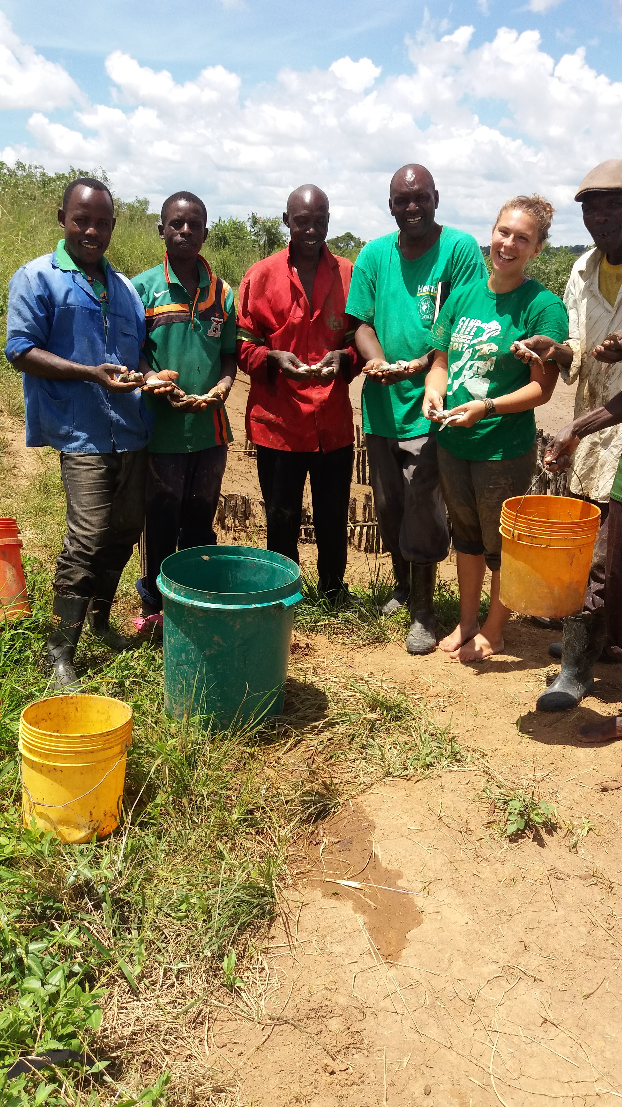
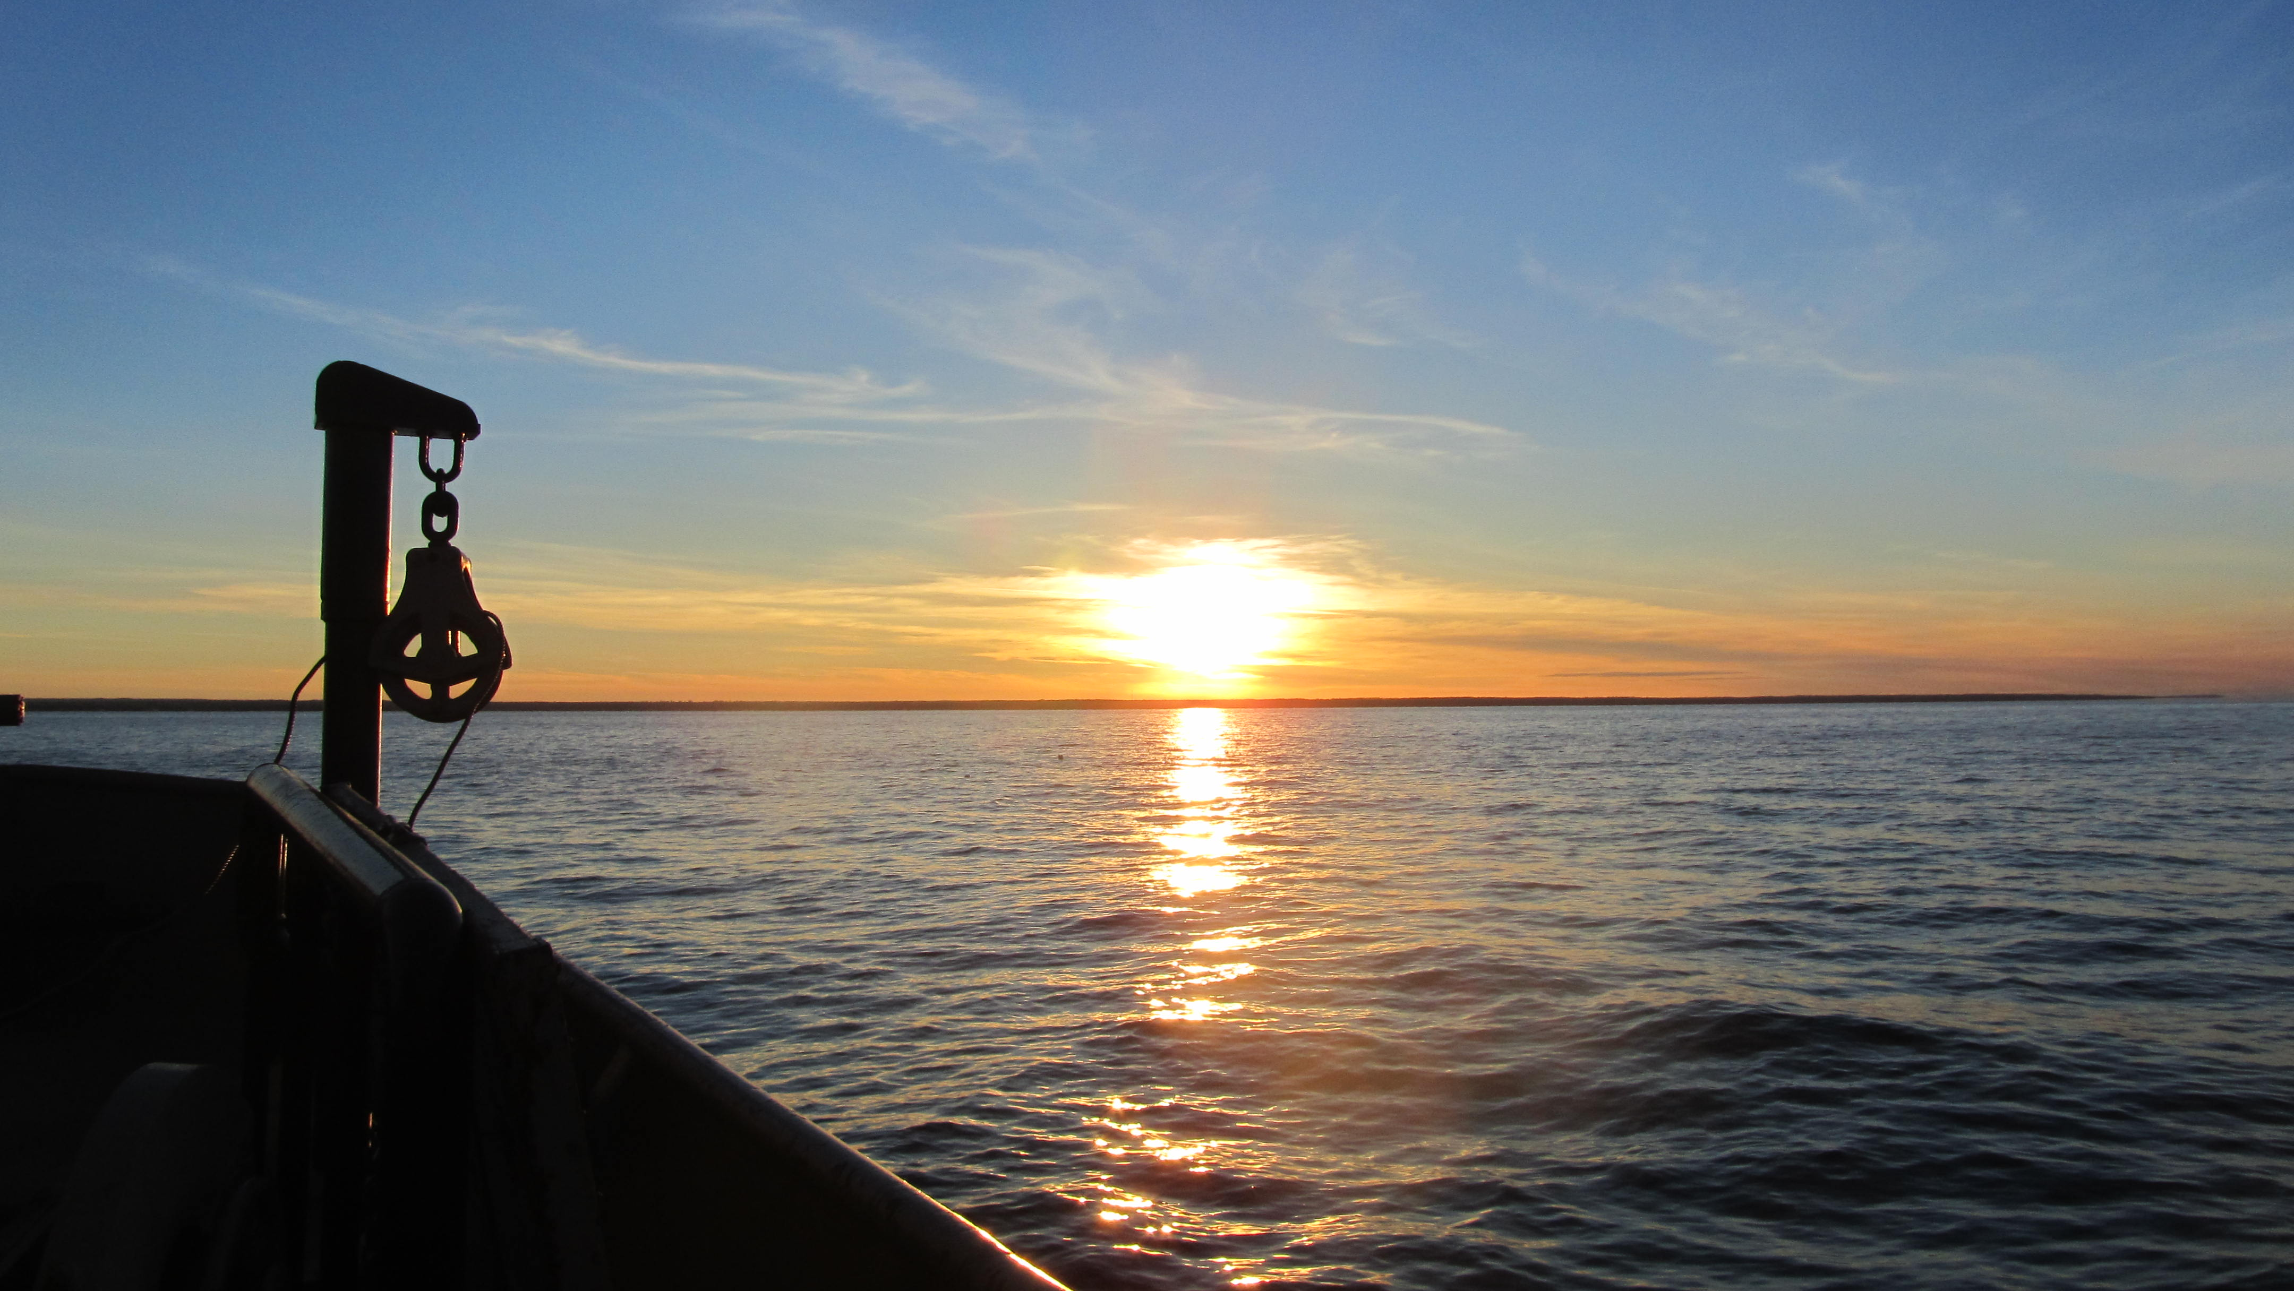
PC Zambia—enhanced love for working with people
EMU—developed love for algae
USGS—cultivated love of lakes and lake ecosystems
+
+

Slide 4
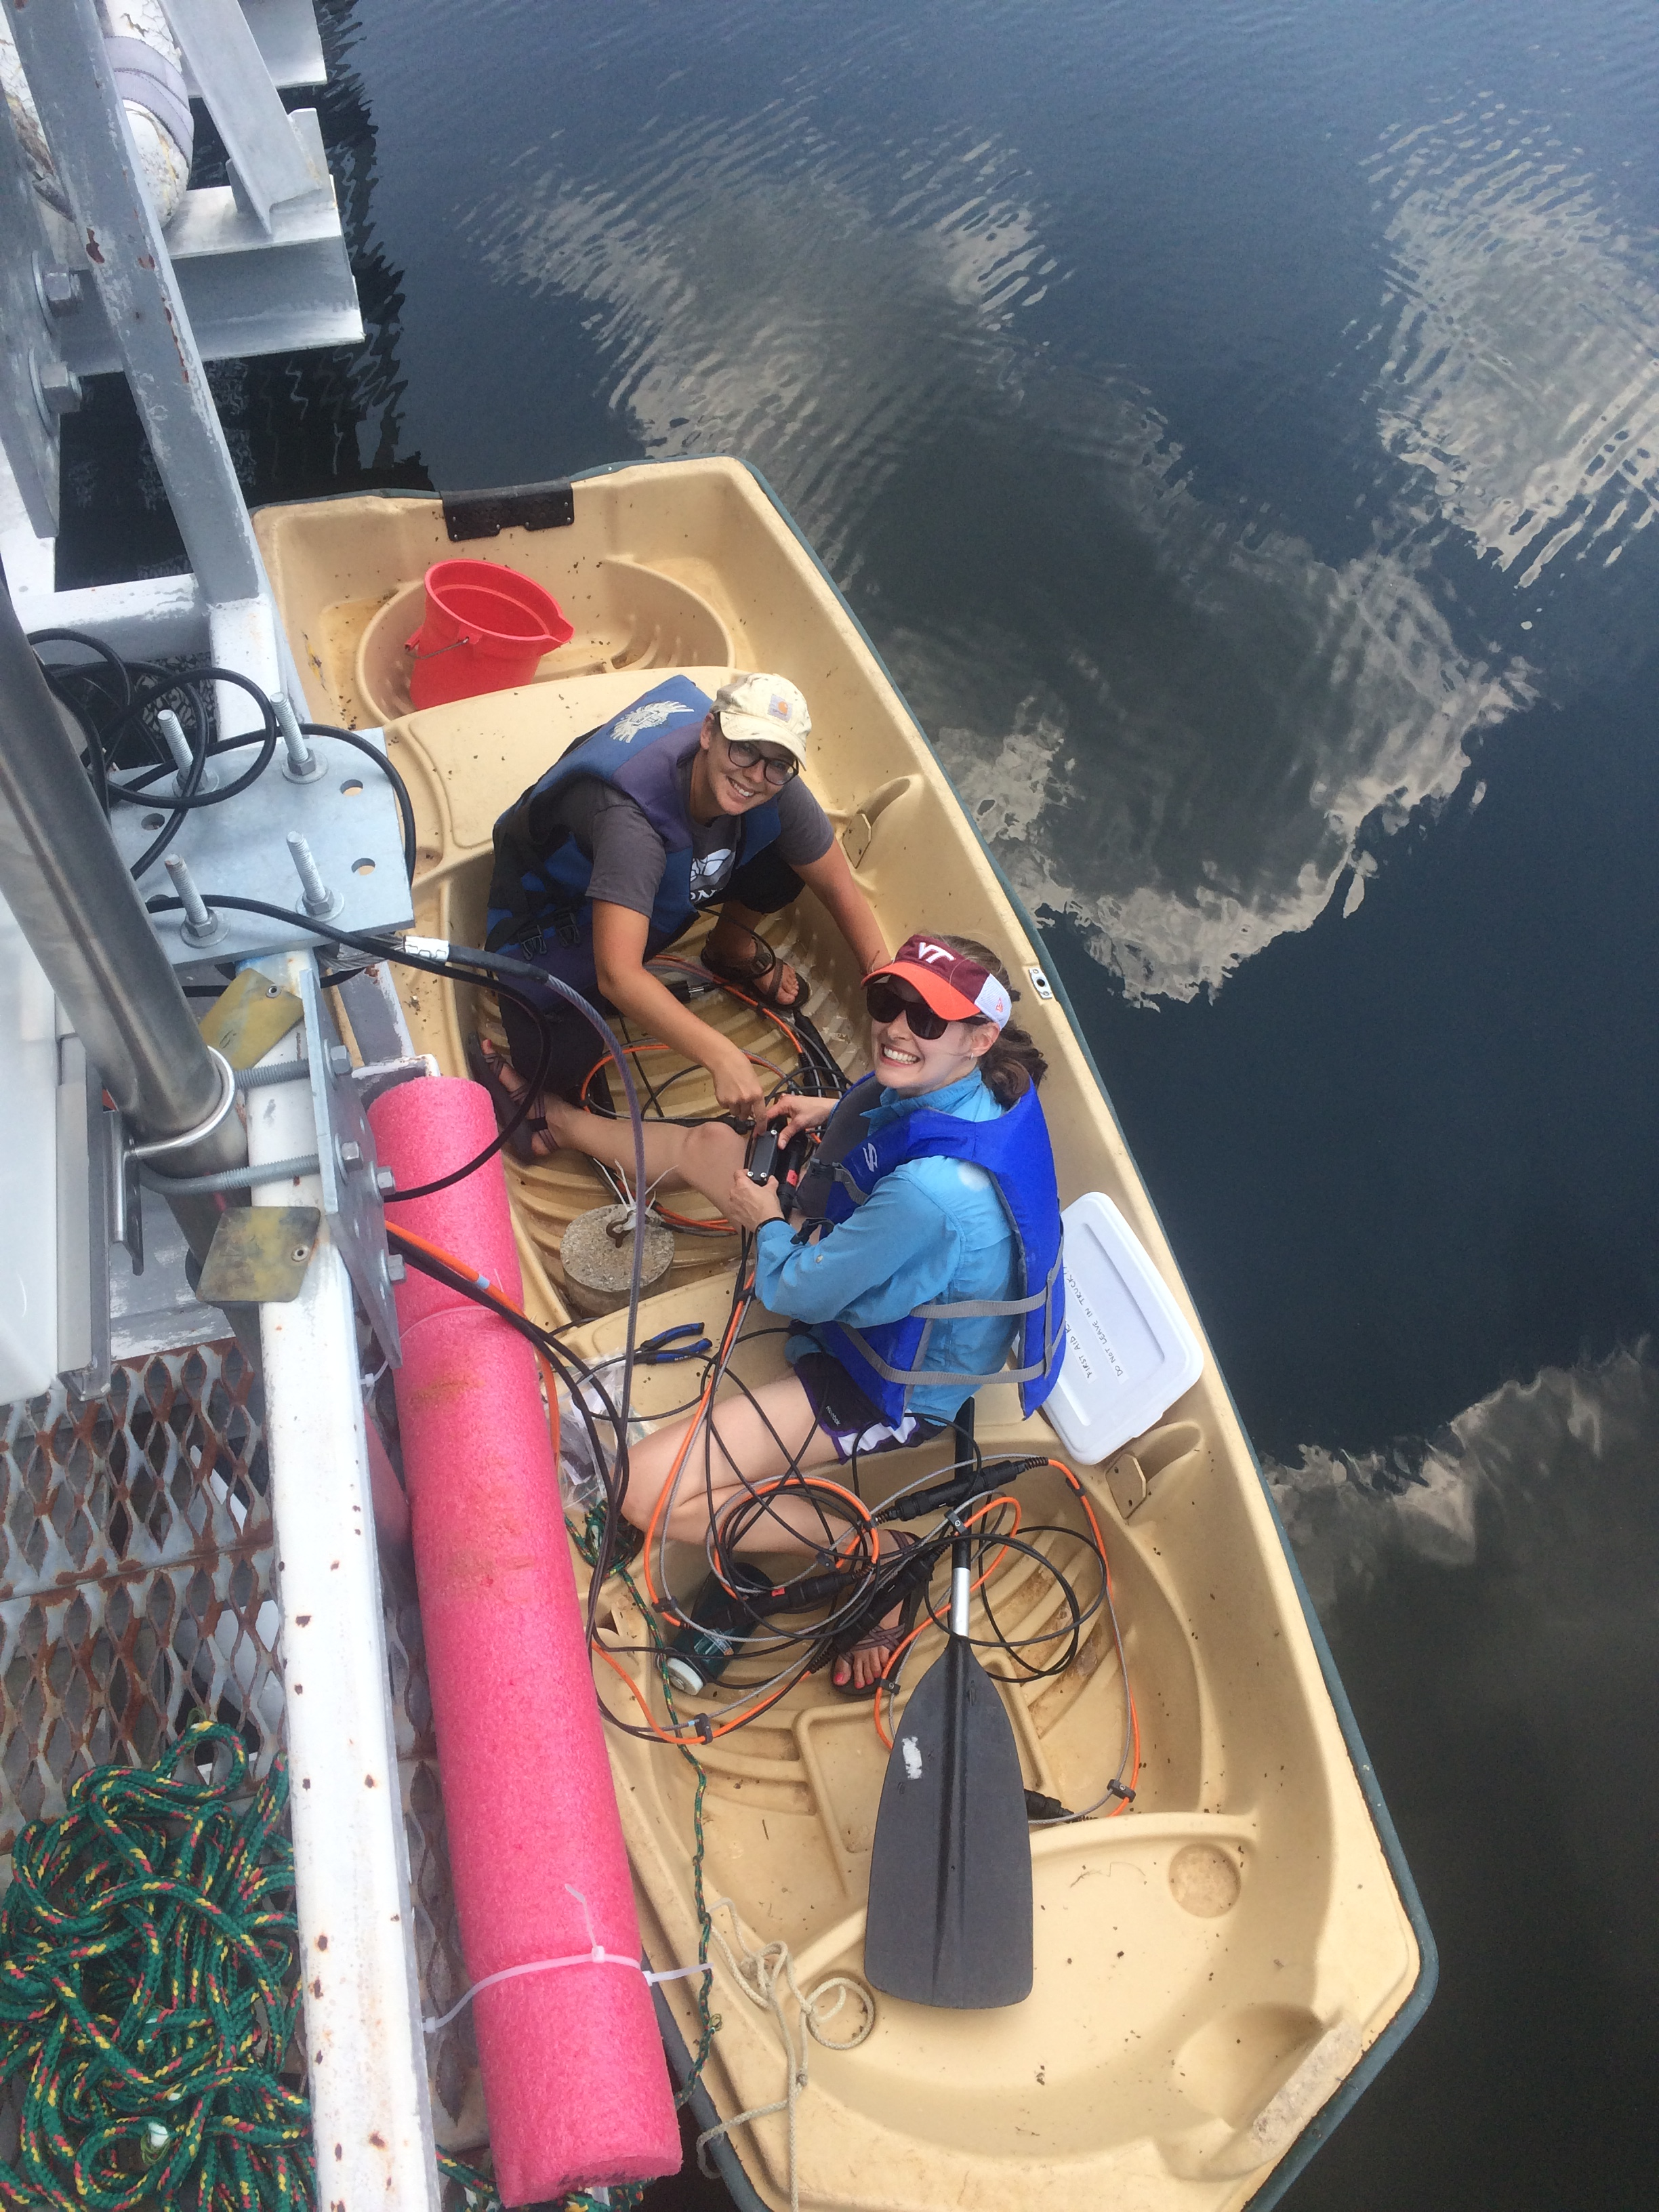
Carey Lab at VT!
Post-degree plans:
Extension Work
-land grant
-non-profit org
-anywhere where I can combine my interests and skills to improve the human relationship to water

Slide 5
Have NSF GRF funding for 3 years…now what?
Now staying for a PhD!
Post-PhD goal: pursuing career in water extension
Logistics issue! Need to have prospectus & POS approved by 1st week of May; Jeff suggested get MS approved and then transition in summer
Letter from CCC & committee
File that with Grad School with new prospectus
Fall 2019 committee meeting to finalize paperwork
SO! Today just focusing on MS first 2 chapters knowing that there are more in the pipeline

Slide 6
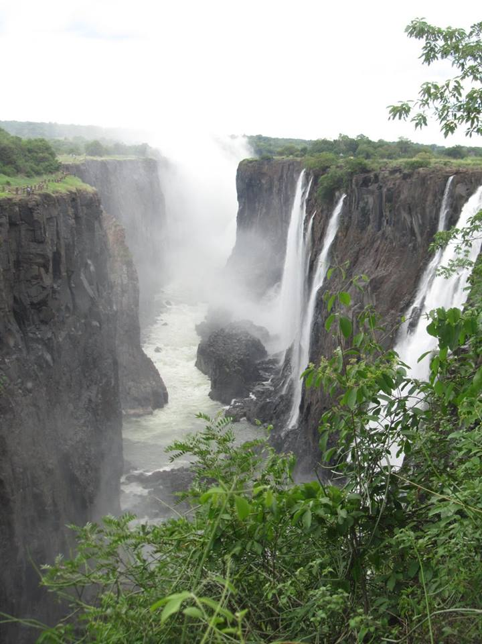
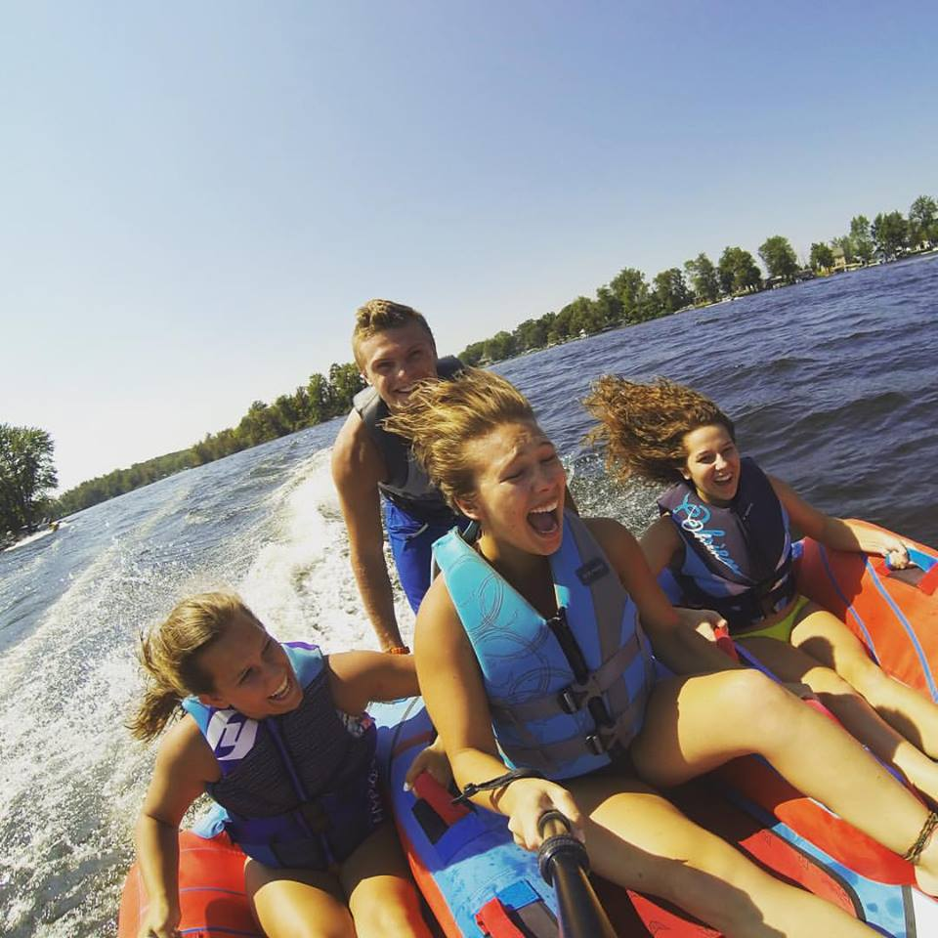
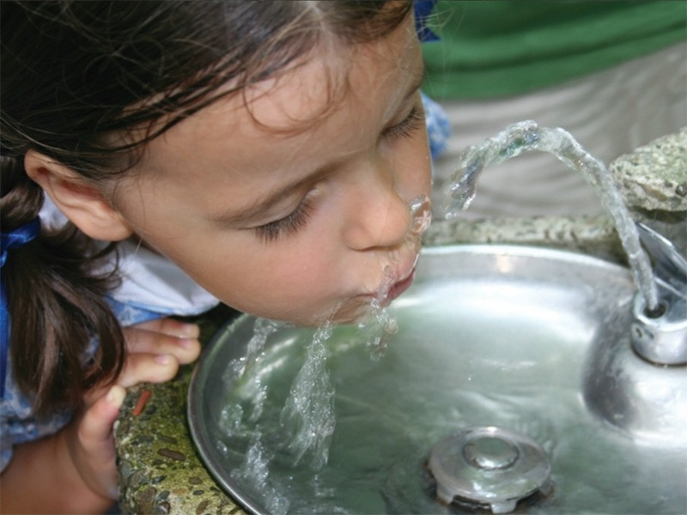
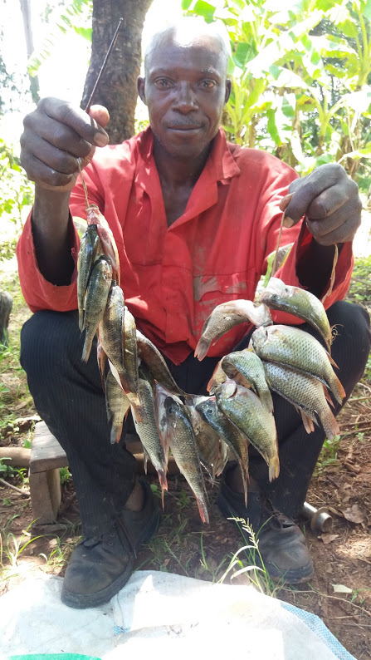
Freshwater resources provide numerous crucial benefits to society
ISTOCKPHOTO
Notes:
Freshwaters across the globe have been intricately interwoven with society and provide services ranging from recreation to aesthetic and cultural enjoyment to providing a source of food and drinking water

Slide 7
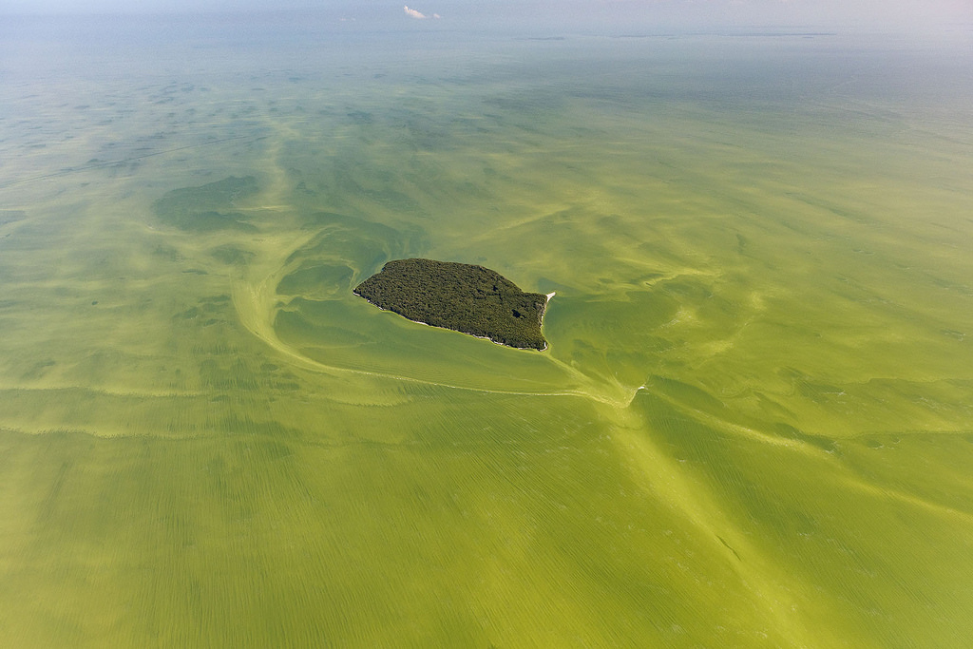
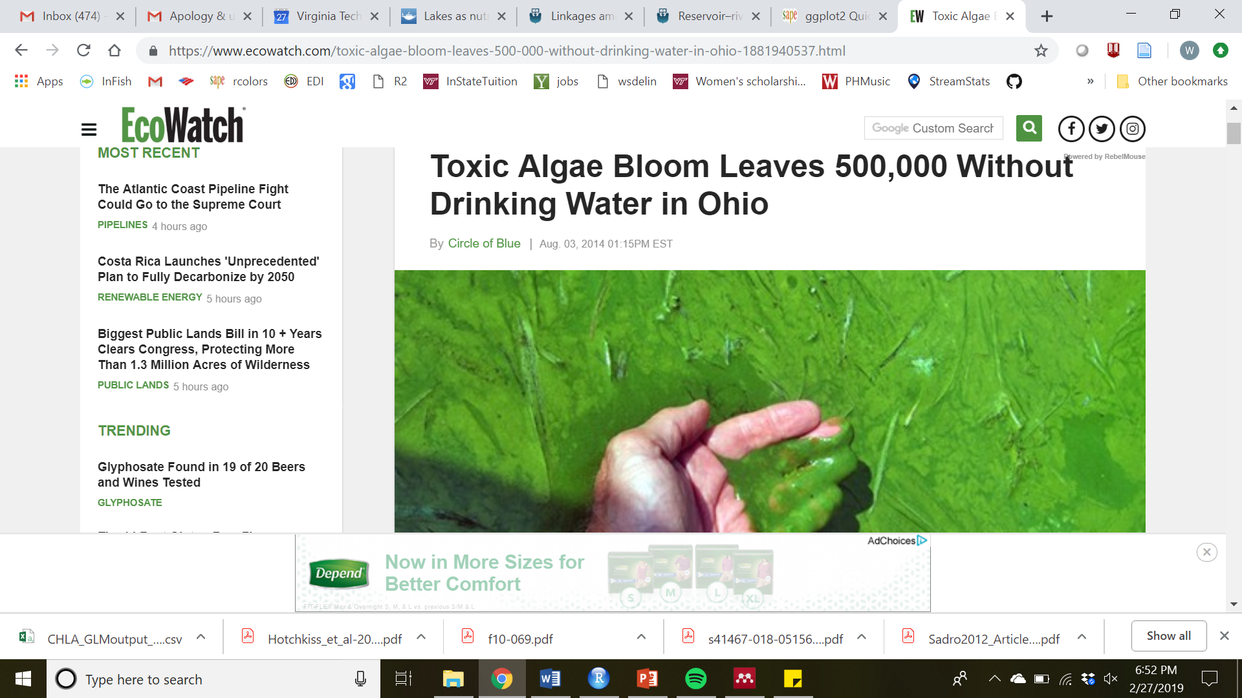
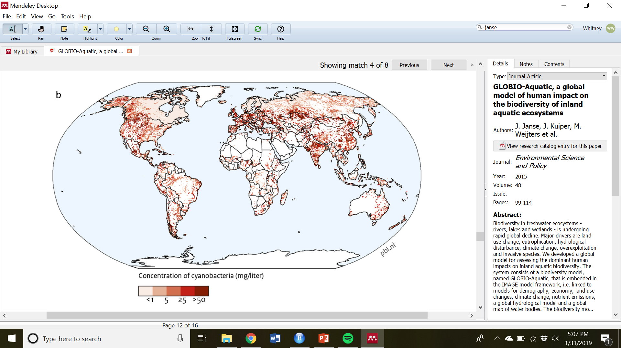
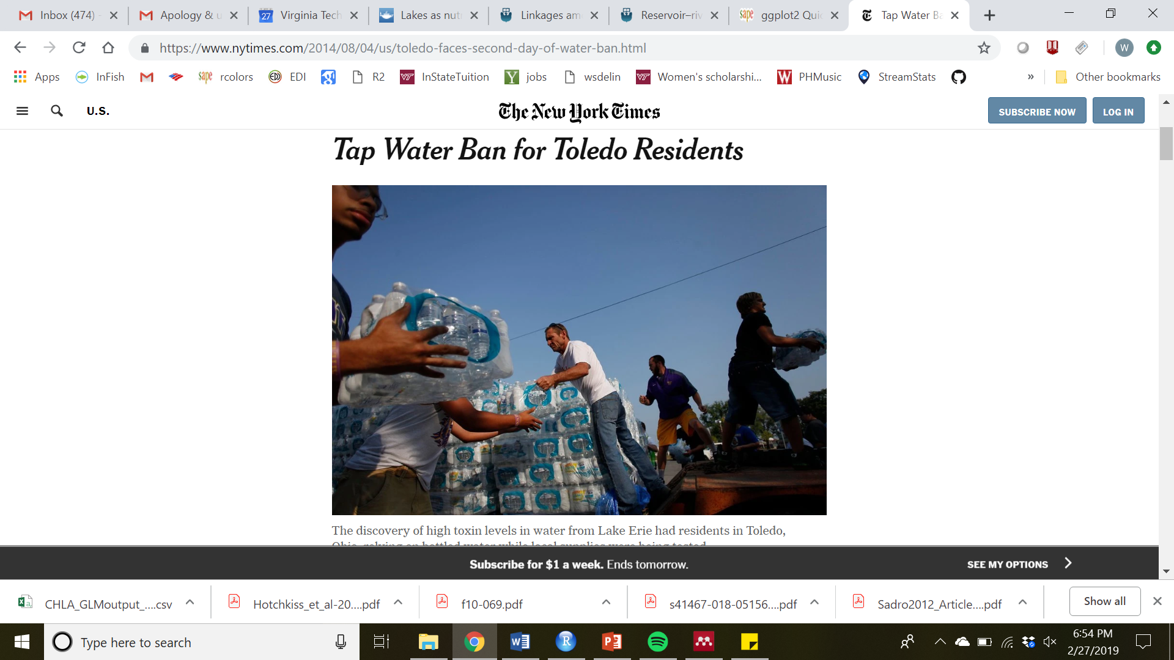
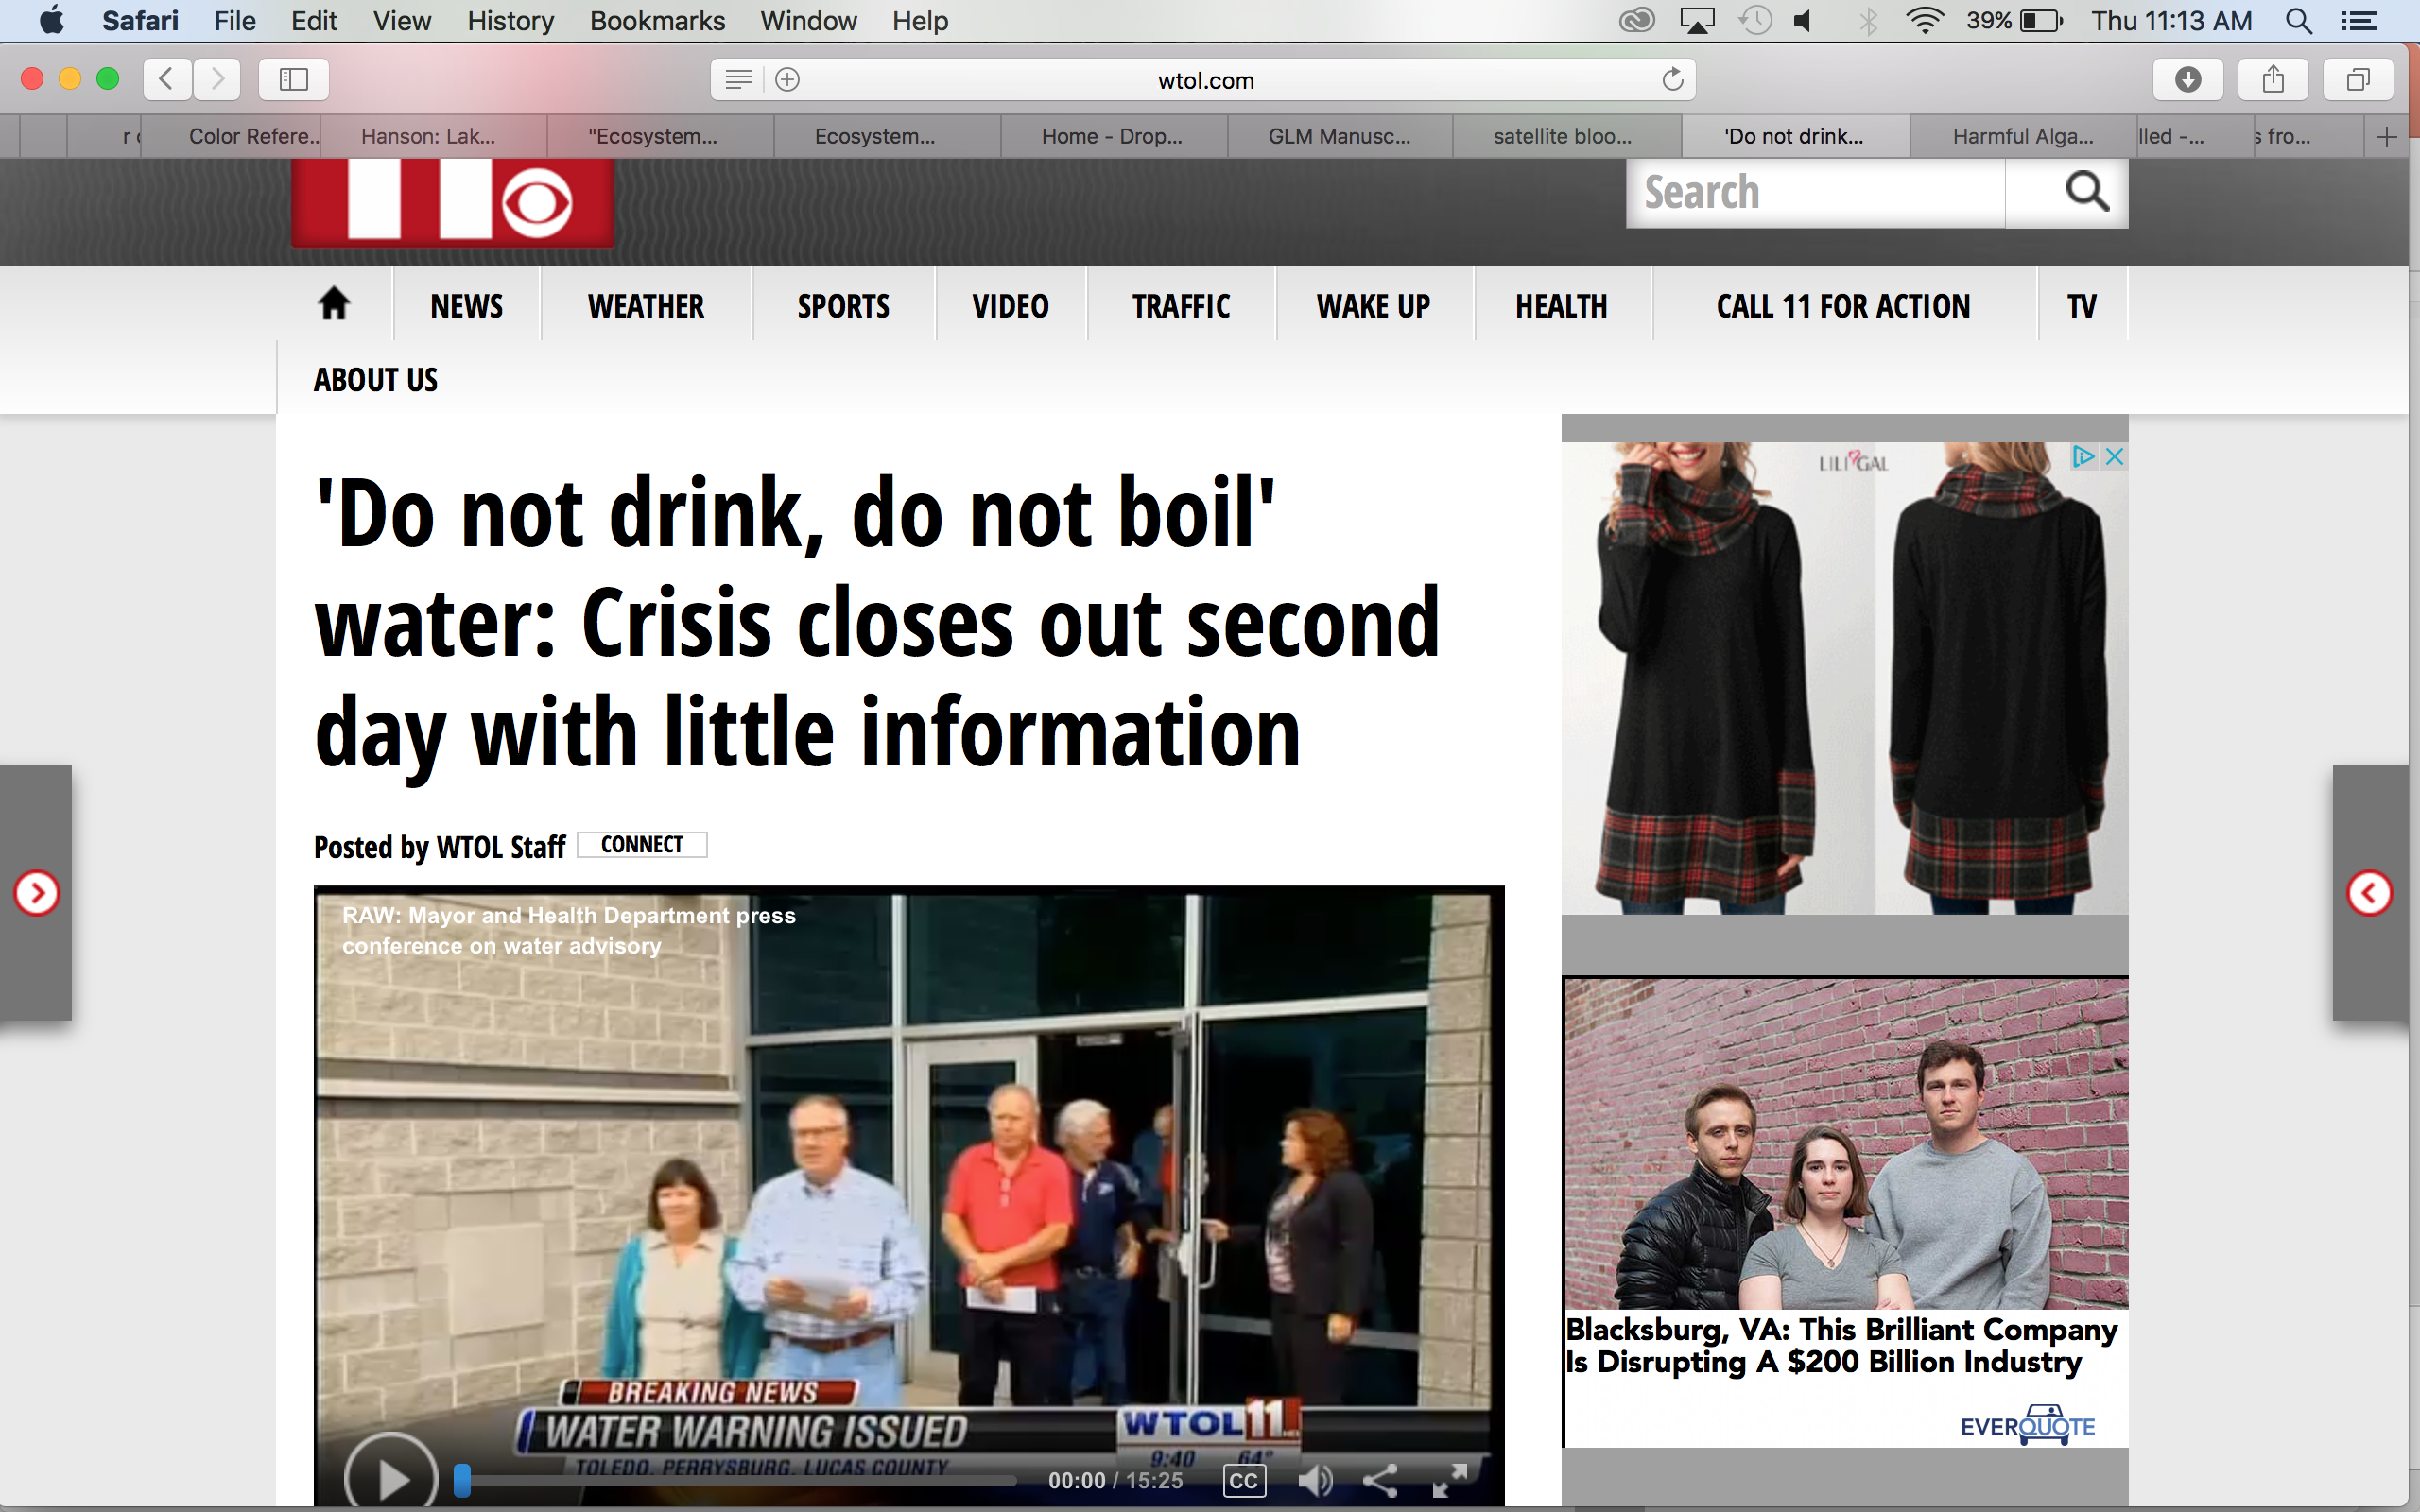
(MODIS) on NASA’s Terra satellite
Janse et al 2015
Photo credit Rodney Witt
Lake Erie HABs 2017, NOAA GLERL
Notes:
If we look into the more recent past at Falling Creek Reservoir, we see that it’s water quality has had some challenges. Here you can see a major algal bloom tha toccurred in the reservoir. And we also know that HABS are occurring across the globe in other systems as well. This here is a picture of a major HAB event in lake erie. In particular I’d like to talk about the bloom that occurred in 2014 which affected the entire lake, especially the eastern basin, and resulted in the loss of water for over 500000 people in Toledo oh for several days. The economic cost for water treatment only was estimated to be over $4 million dollars,
The total economic impact from the 2011 bloom was based on the following estimates: $16 million for diminished property values, $20 million for lost tourism revenue, $31 million for lost recreational opportunities and $4 million for water treatment purposes.
(http://www.wtol.com/story/30813255/study-the-economic-effect-of-harmful-algal-blooms-in-lake-erie/)

Slide 8
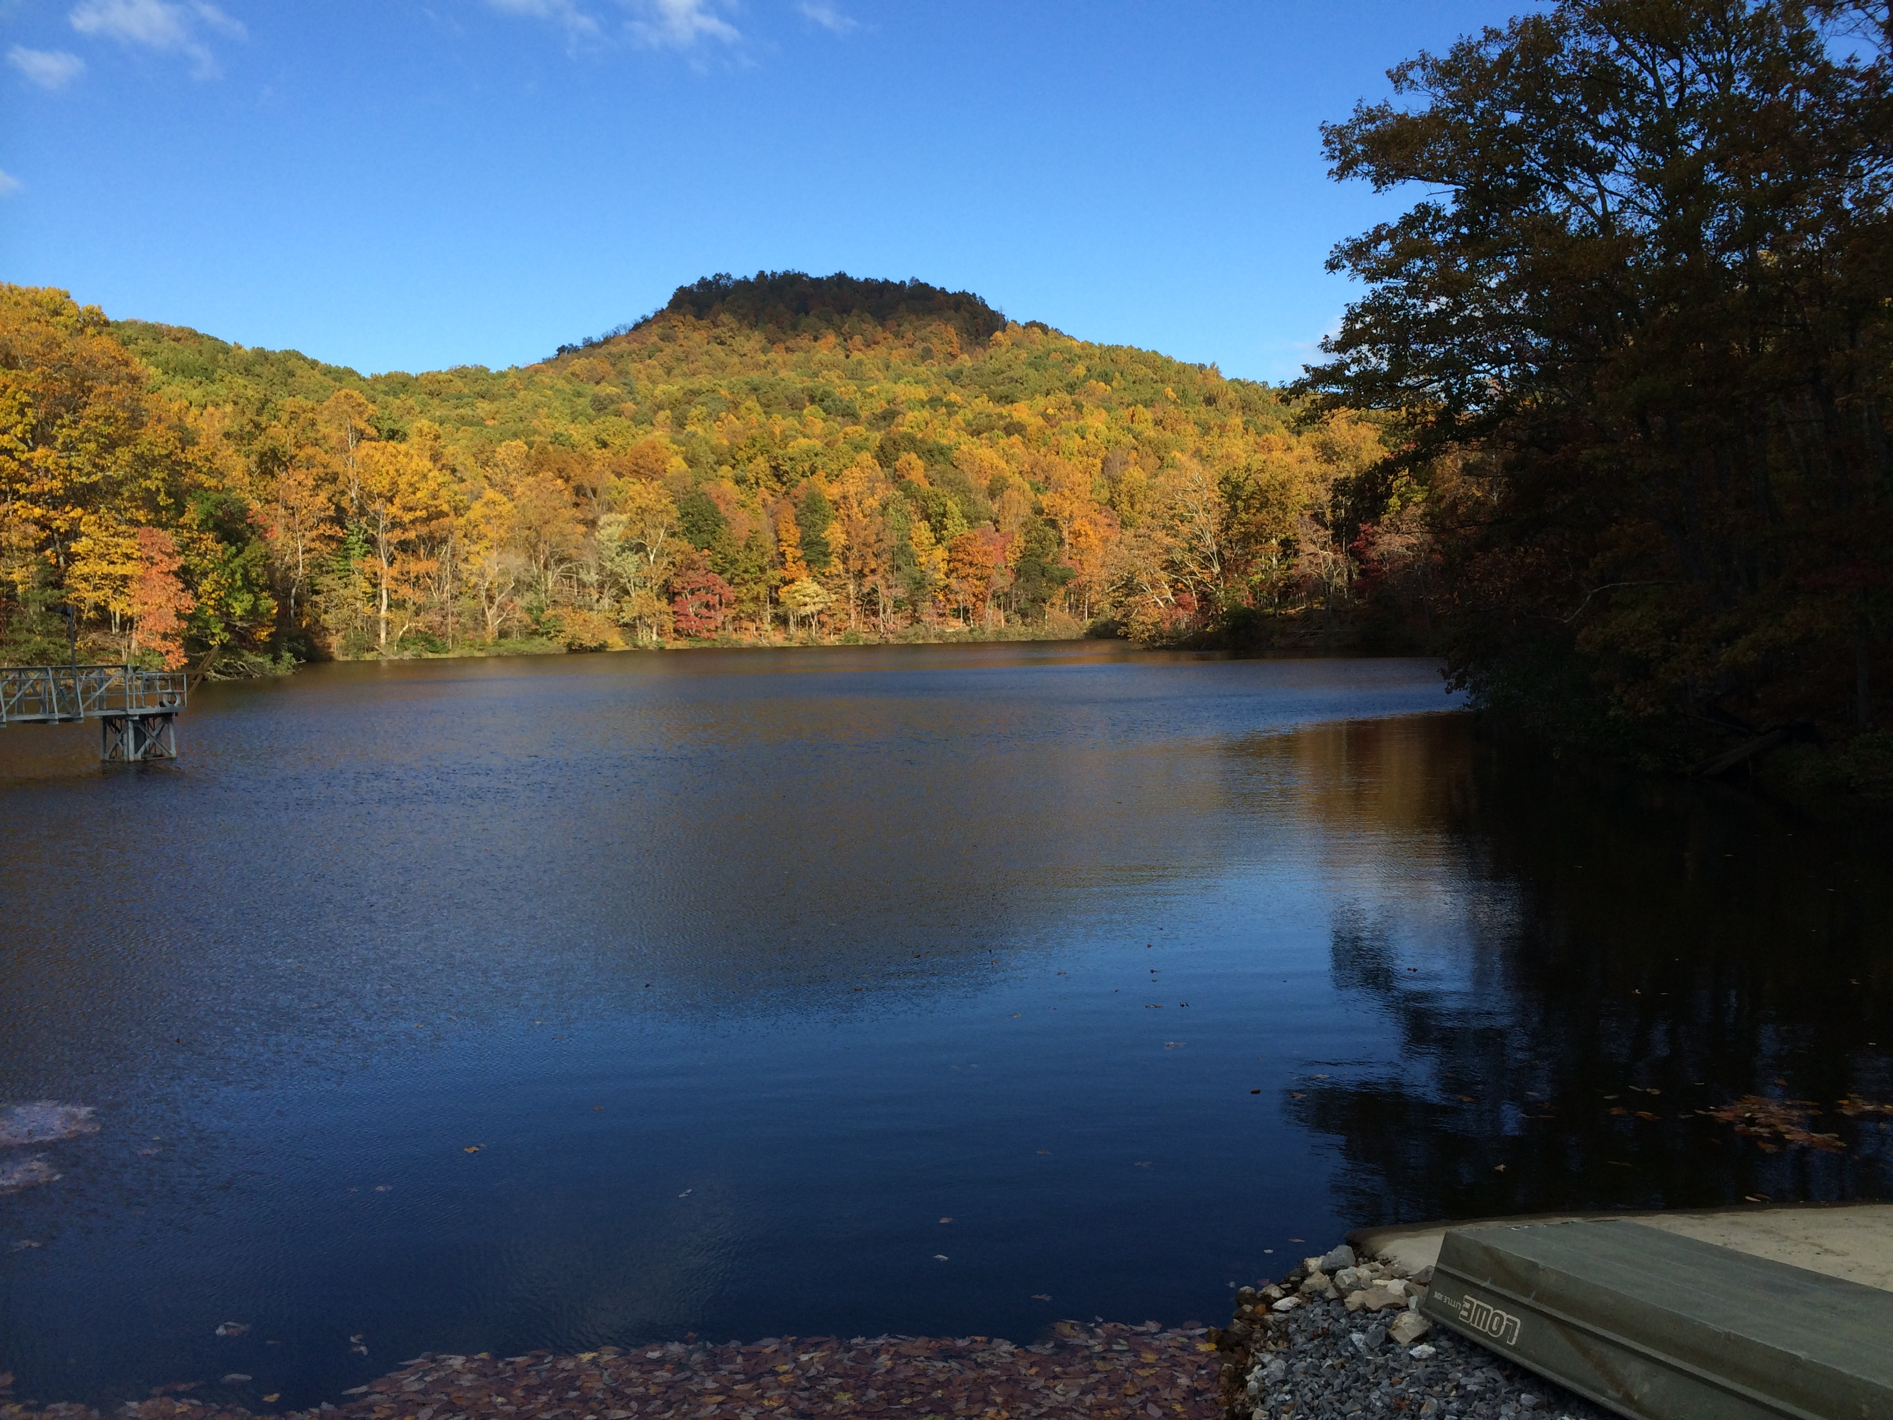
Chapter 1: Developing near-term forecasts of phytoplankton in a drinking water reservoir
Notes:
With these major human impacts in mind, developing forecasts of water quality is increasingly important to water managers and society as a whole.

Slide 9
How do we forecast?
Future driver data
Forecast
Historical data
Model
Hindcast of past conditions
Calibration of model
Notes:
monitoring data -> calibration of model to hindcast past conditions -> feed with future driver data -> forecast

Slide 10
Ecological Forecasting
…is still developing!
Therefore, what approach/model to use?
Current ecological forecasts use either empirical or process-based models
Literature review, n = 17
65% empirical
35% process-based
Also support for using an ensemble of models, which has been used in other fields using forecasting
Notes:
Verbally define empirical and process-based

Slide 11
Chapter 1: Developing near-term forecasts of phytoplankton in a drinking water reservoir
Question 3
Question 2
Future driver data
Forecast
Question 1: How well can an empirical model and a process-based model hindcast observed phytoplankton dynamics?
Question 3: How does an ensemble model approach improve 16-day forecasts of phytoplankton over a single model approach?
Question 2: How well can an empirical model and a process-based model forecast phytoplankton dynamics over a 16-day period?
Historical data
Model
Question 1
Hindcast of past conditions
Calibration of model

Slide 12
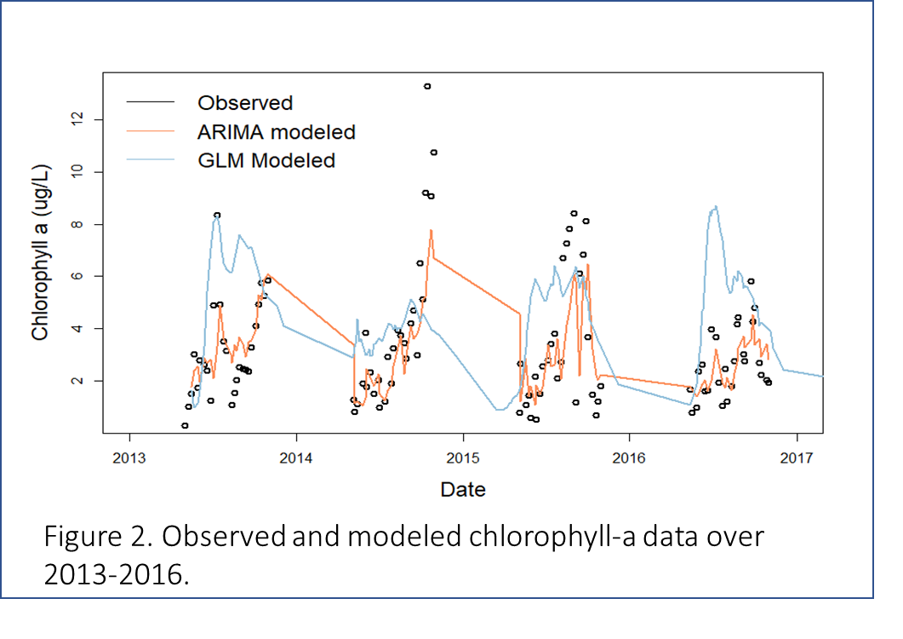
Question 1: How well can an empirical model and a process-based model hindcast observed phytoplankton dynamics?
ARIMA
Chla_{t} = Chla_{t-1} – Discharge_{t} – Shortwave_{t}
R² = 0.49
RMSE = 1.71 ug/L
GLM-AED
R² = 0.05
RMSE = 3.07 ug/L
Notes:
Models calibrated from 2013-2016 and validated over 2018.
Have explanation for directions of drivers

Slide 13
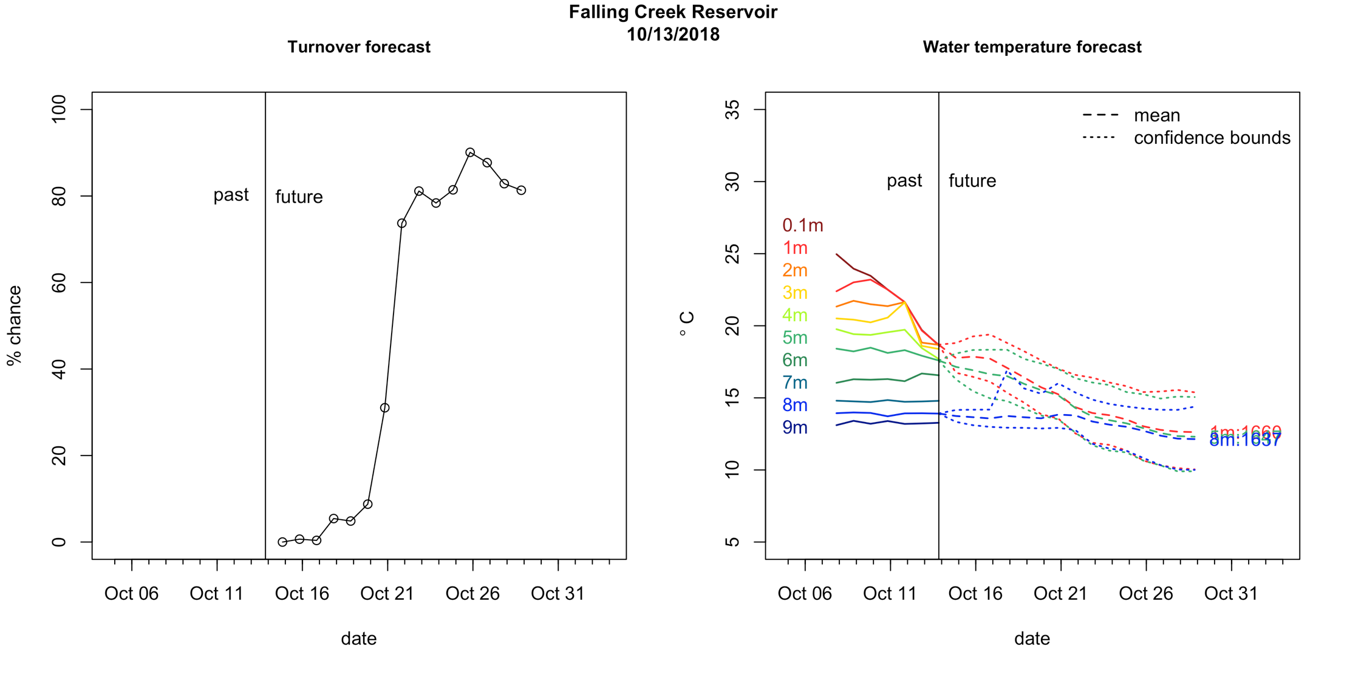
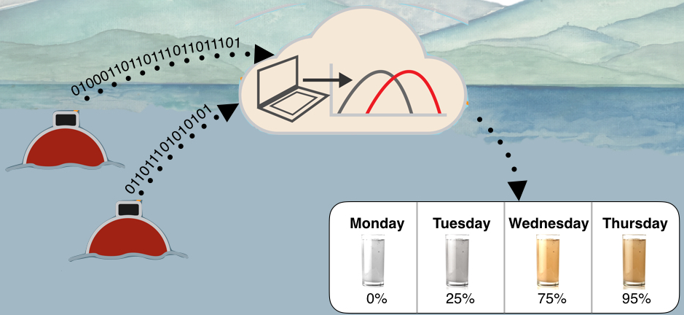

Question 2: How well can an empirical model and a process-based model forecast near-term phytoplankton dynamics over a 16-day period?
Notes:
Discuss discharge and getting the gateway up to use arima

Slide 14
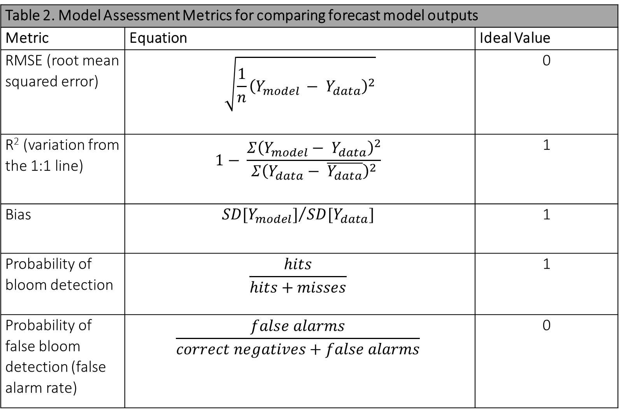
Table 2. Model Assessment Metrics for comparing forecast model outputs
Metric | Equation | Ideal Value
RMSE (root mean squared error) | $$\sqrt{\frac{1}{n}{\left(Y_{model }− Y_{data}\right)}^{2}}$$ | 0
R² (variation from the 1:1 line) | $$1− \frac{Σ{\left(Y_{model}− Y_{data}\right)}^{2}}{Σ{\left(Y_{data}− \overline{Y_{data}}\right)}^{2}}$$ | 1
Bias | $${SD[Y_{model}]}/{SD[Y_{data}]}$$ | 1
Probability of bloom detection | $$\frac{hits}{hits+misses}$$ | 1
Probability of false bloom detection (false alarm rate) | $$\frac{false alarms}{correct negatives+false alarms}$$ | 0

Slide 15
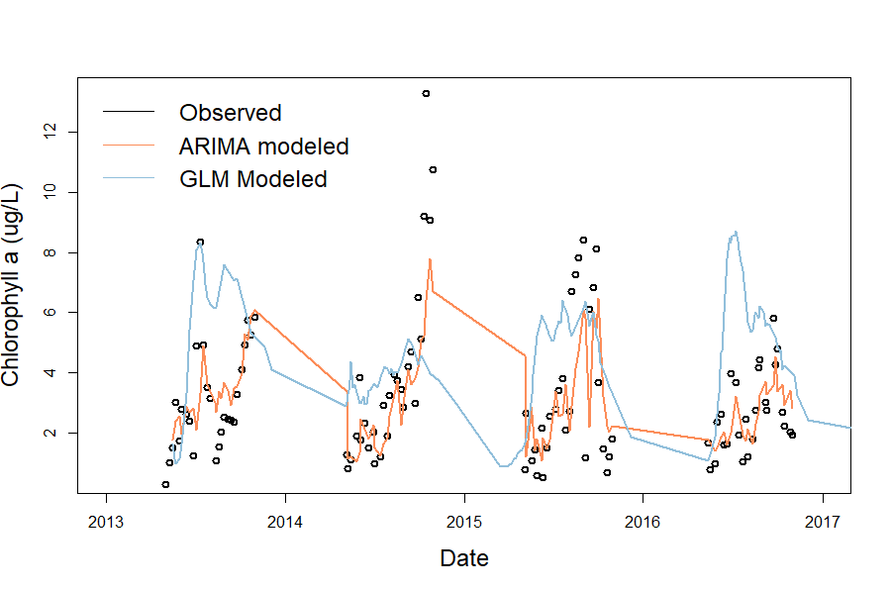
Question 3: Ensemble Model Averaging

Slide 16
Model averaging/ensembles
Combining the explanatory power of multiple models
Developing a third empirical model that is triggered under certain conditions which lead to a bloom
Using sensor datasets over summer 2019 to identify if/what conditions lead to blooms
Could serve as an ‘early warning’ for managers

Slide 17
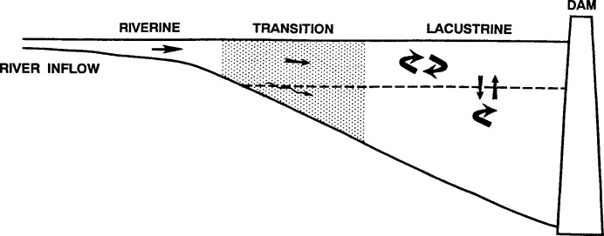
Chapter 2: Spatial heterogeneity of nutrients and phytoplankton along a double reservoir continuum
Nitrogen
Wetzel et al 2001
Notes:
Thornton pg 10
Add in animations of different distributions of n, p, and chla

Slide 18
Chapter 2: Spatial heterogeneity of nutrients and phytoplankton along a double reservoir continuum
Phosphorus
Wetzel et al 2001

Slide 19
Chapter 2: Spatial heterogeneity of nutrients and phytoplankton along a double reservoir continuum
Chlorophyll-a
Wetzel et al 2001

Slide 20
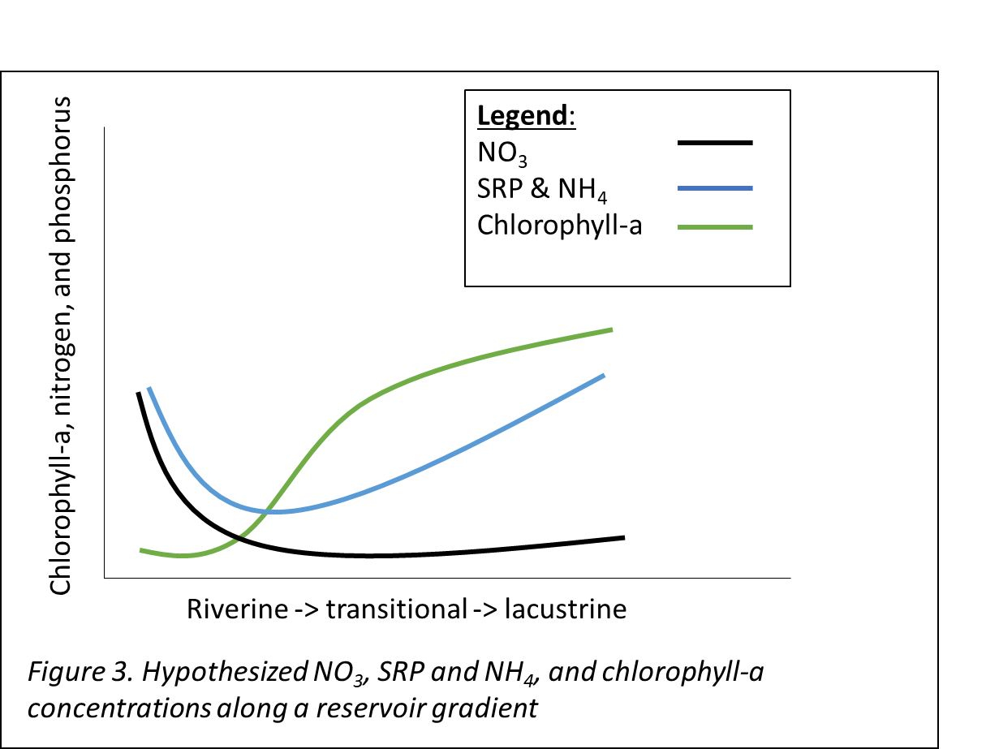
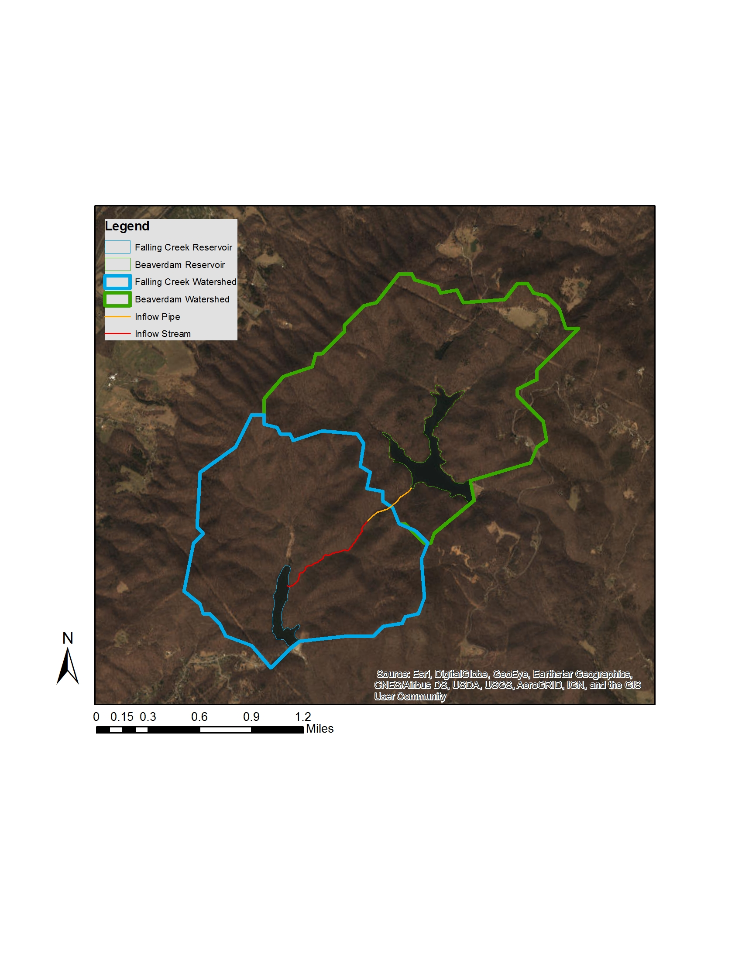
Question 1: What is the longitudinal heterogeneity of nitrogen, phosphorus, and chlorophyll-a along a double reservoir continuum?
What about factors that cause changes in these patterns?
Notes:
System where we can remove catchment impacts

Slide 21
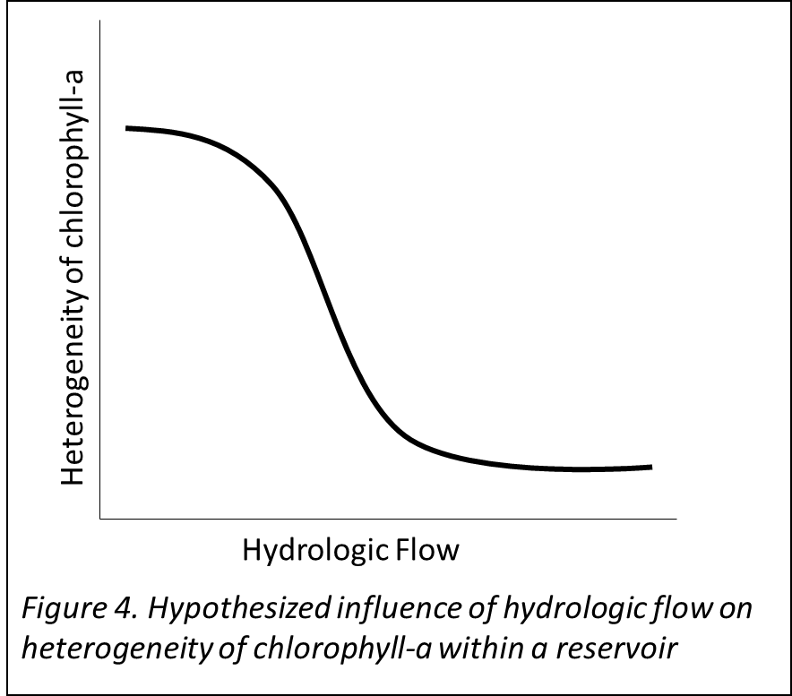
Heterogeneity influenced by hydrologic flow?
Wetzel et al 2001
Notes:
Also plug for discharge being really important ot chl based on ch 1

Slide 22
Proposed sampling, Summer 2019
B 200
Beaverdam + Falling Creek Reservoir Continuum
17 sites
8 sampling days
Seasonal (n = 5)
Hydrologic gradient (n=5 adaptive samplings)
Concurrent OC quality study—Alex H.
B 100
B30
B20
B45
B01
B50
F 200
F 101
F 102
F 100
F20
F 99
F30
F45
F50
F01
Figure 5. Proposed sampling sites ( n= 17) along the reservoir gradient from BVR to FCR.

Slide 23
What variables to collect?
Total and soluble nitrogen and phosphorus
Chlorophyll-a (filtering + ethanol extraction)
Water temperature, DO, and conductivity
Discharge at stream sites
Calculated with flowmeter
Salt slugs?
Study in combination with post-doc AH assessing carbon quality
EEMs and BDOC incubations

Slide 24
What depth to sample?
Sampling these variables at what depth?
Surface (~0.1m) used in many spatial heterogeneity studies
However, likely that some stream water may be entrained at depth
Is it feasible to measure deep water on the continuum?

Slide 25
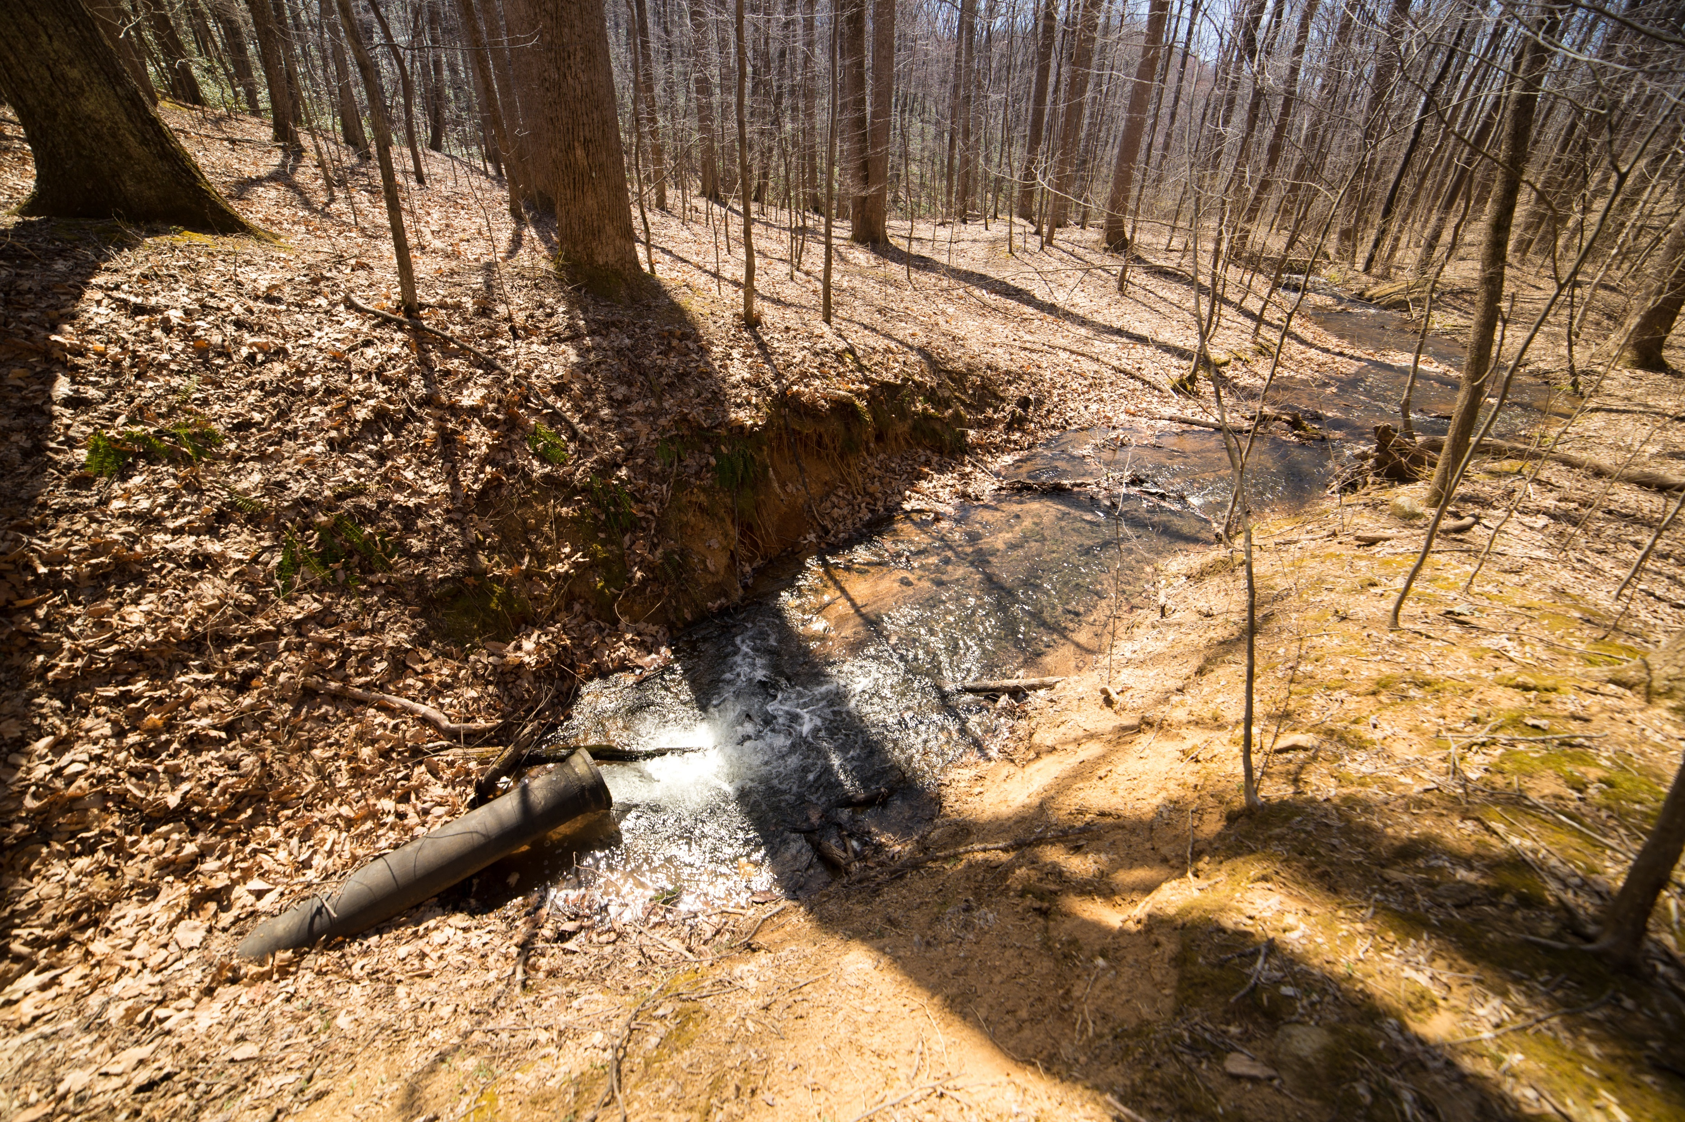
Back-up Questions
Reservoir chain effect on heterogeneity and relative concentrations of N, P, and chla
Landscape position and nutrient export
Chain effect on downstream reservoir
Influence of oxygenation on
nutrient dynamics

Slide 26
Table 3. Proposed timeline for Chapter 1 Black boxes indicate completed tasks, gray boxes indicate proposed completion
 | Fall 2018 | Spring 2019 | Summer 2019 | Fall 2019 | Spring 2020
Develop ARIMA GLM-AED, Ch. 1
Calibrate GLM-AED, Ch. 1
Produce hindcasts, Ch. 1
Validate model, Ch. 1 (Q1)
Adapt FLARE code for ARIMA, Ch. 1 (Q2)
Summer field sampling, Ch 2
Create integrated model average, Ch. 1 (Q3)
Nutrient laboratory analyses, Ch. 2
Nutrient statistical analyses, Ch. 2
Run forecasts in FLARE, Ch. 1 (Q2)
Manuscript writing and edits, Ch. 2
Submit manuscript for Chapter 1, target journal: Ecological Applications
Submit manuscript, Ch 2; possible target journals: L&O, Ecosystems, Biogeosciences

Slide 27
Next steps!
Use this summer’s data to inform development of next 2 chapters for PHD prospectus, current ideas are:
Chapter 3: GROW program in the Netherlands?
Apply Feb 1, 2020
Study 2-12 months from Fall 2020-Fall 2021
Chapter 4?????
Set up forecasting in a location with different resources than FCR (Sunapee??)
Include a social science or community engagement aspect?

Slide 28
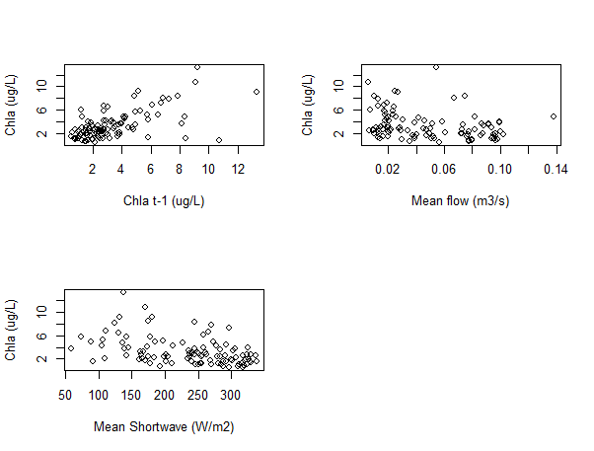
Ch 1: Drivers in ARIMA

Slide 29
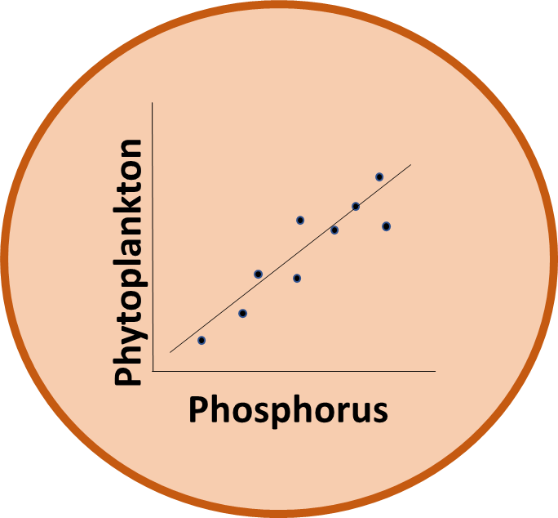




Developing our empirical model: ARIMA
AutoRegressive Integrated Moving Average generalized linear model
53 candidate variables over 4 years (2013-2016)
Variables removed due to correlation and predictability, ~5 chosen
Model iterations compared based on AICc and parsimony
Final model selected: Chlorophyll-a = discharge + shortwave radiation

Slide 30
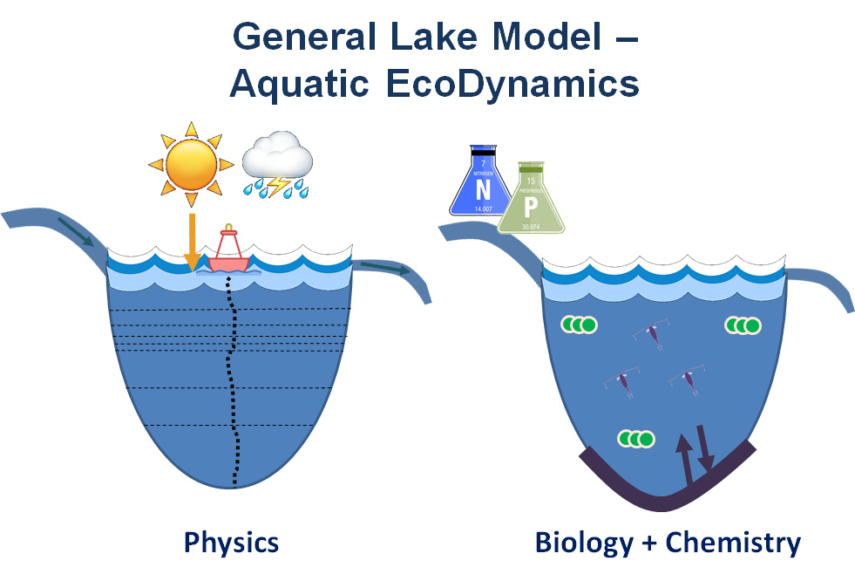
GLM Calibration
Observed water temperature
Modeled water temperature
Using field data from 2013-2017 to fine- tune model parameters and improve model fit
Aim to capture seasonal dynamics in FCR
Temperature °C

Slide 31
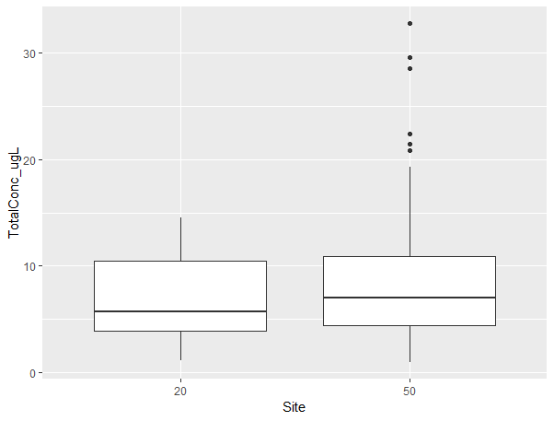

Slide 32
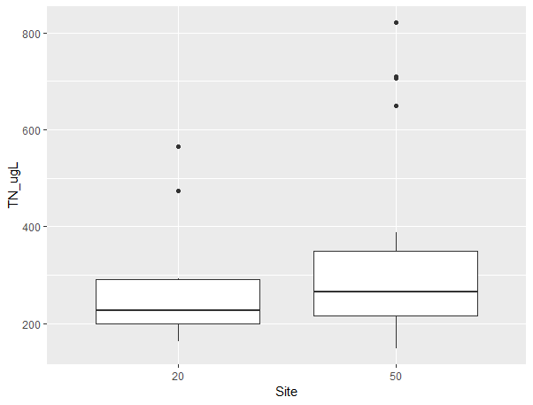
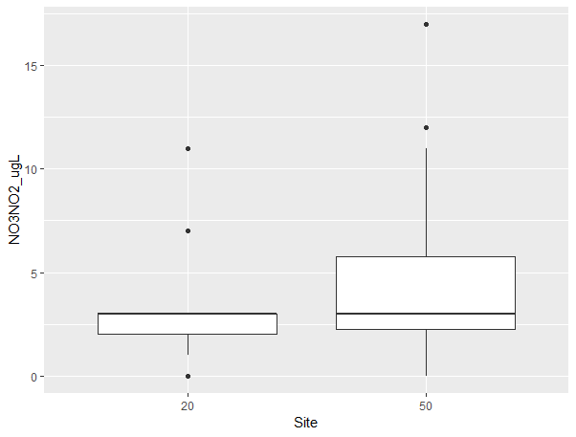
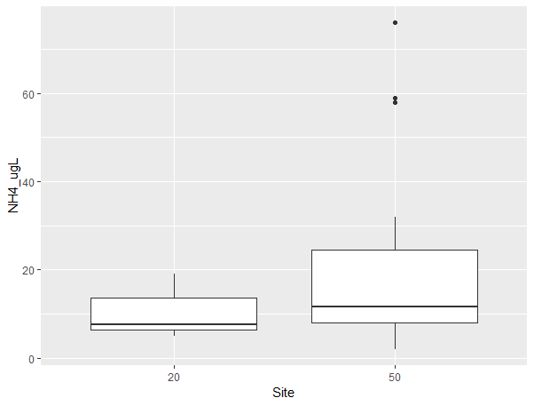
TN (ug/L)
NO3NO2 (ug/L)
NH4 (ug/L)

